Slide 1
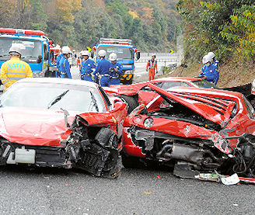
CHICAGO Traffic Crash Injury
Overview
This project analyzes historical traffic crash data from the City of Chicago to predict the primary contributory cause of a car accident. The goal is to provide insights for city planners, policymakers, and road safety authorities to reduce accidents and improve public safety.
Using machine learning, we explore factors such as weather, lighting, roadway conditions, speed limits, and temporal patterns to identify high-risk scenarios that are likely to lead to accidents or injuries.
This Photo by Unknown Author is licensed under CC BY-NC-ND

Slide 2
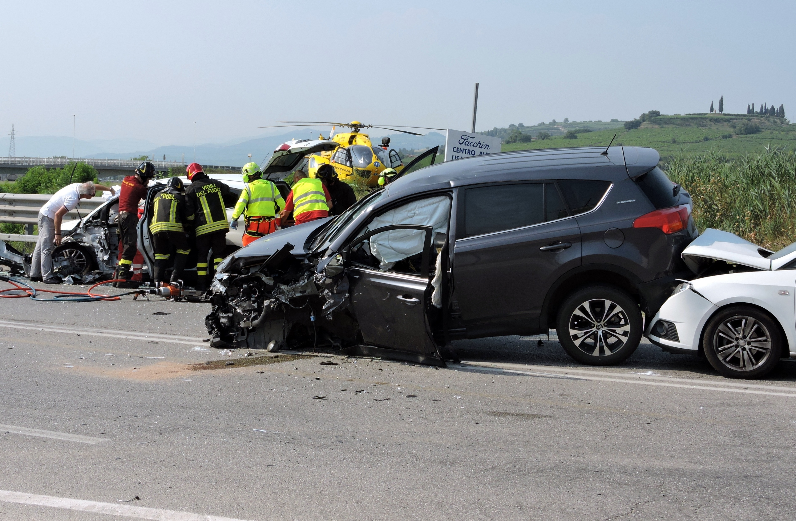
Problem statement
Traffic accidents in Chicago City lead to injuries, death, and massive destruction of properties. It is imperative to know what causes accidents with a view of enhancing road safety. The project will determine the main contributory factor to a car accident depending on the environmental, road, and time factors. The final objective is to offer informational input that can assist policymakers and people in charge of ensuring safety on the road to minimize accidents and injuries.

Slide 3
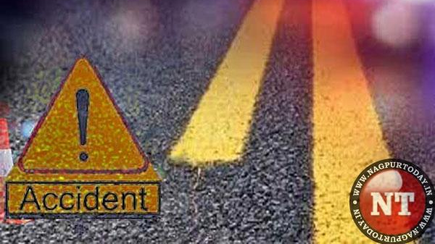
Project Objective
Exploratory Data Analysis (EDA)
Crash trends hour by hour, day by day, month by month.
Checking on the weather, light and road surface conditions.
Determining accident causal patterns.
One Week Of Data Cleaning and Feature Engineering.
Handling missing values
Grouping unusual primary contributory causes as an OTHER category.
Categorical features which are one-hot encoded.
Modeling
Logistic Regression: Baseline model to model that is linear.
Random Forest: Model of Ensemble to identify complicated patterns and interaction.
Model Evaluation
Measures: Accuracy, Precision, Recall, F1-score.
Comparison on unseen test data models.
It was followed by confusion matrix analysis to determine wrongly classified causes.
Business Recommendations and insights.
Peak crash periods denote that the enforcement of a specific traffic is necessary.
The light conditions and visibility affect the risk of accidents.
High risk conditions, locations and times are some of the areas that can be targeted by road safety interventions.
This Photo by Unknown Author is licensed under CC BY-SA-NC

Slide 4
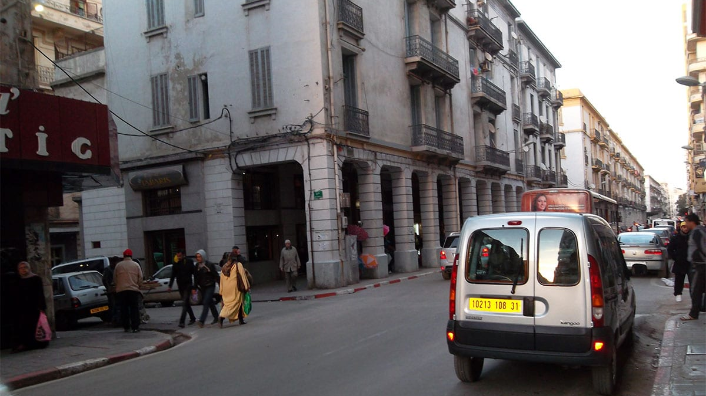
Solution approach
Data Cleaning & Preprocessing
Handle missing or inconsistent values.
Engineer features such as crash hour, day of week, and binned contributory causes.
One-hot encode categorical variables (weather, lighting, road surface).
Exploratory Data Analysis (EDA)
Visualize crash distribution by time, weather, and road conditions.
Identify patterns and trends in accident occurrence.
Modeling
Train Logistic Regression as a baseline model.
Train Random Forest Classifier to capture nonlinear relationships.
Evaluate models on unseen test data using metrics like accuracy, precision, recall, and F1-score.
Insights & Recommendations
Analyze feature importance from Random Forest.
Provide actionable strategies for reducing high-risk crashes.
This Photo by Unknown Author is licensed under CC BY-SA-NC

Slide 5

Data understanding
Source: City of Chicago Traffic Crash Data (2017–present)
Dataset Size: Hundreds of thousands of crash records
Key Features:
Environmental: WEATHER_CONDITION, LIGHTING_CONDITION, ROADWAY_SURFACE_COND
Vehicle & Road: POSTED_SPEED_LIMIT, LANE_CNT
Temporal: CRASH_HOUR, CRASH_DAY_OF_WEEK, CRASH_MONTH
Crash Outcomes: Number of injuries, primary contributory cause
Target Variable: PRIM_CONTRIBUTORY_CAUSE (binned to reduce rare categories)

Slide 6
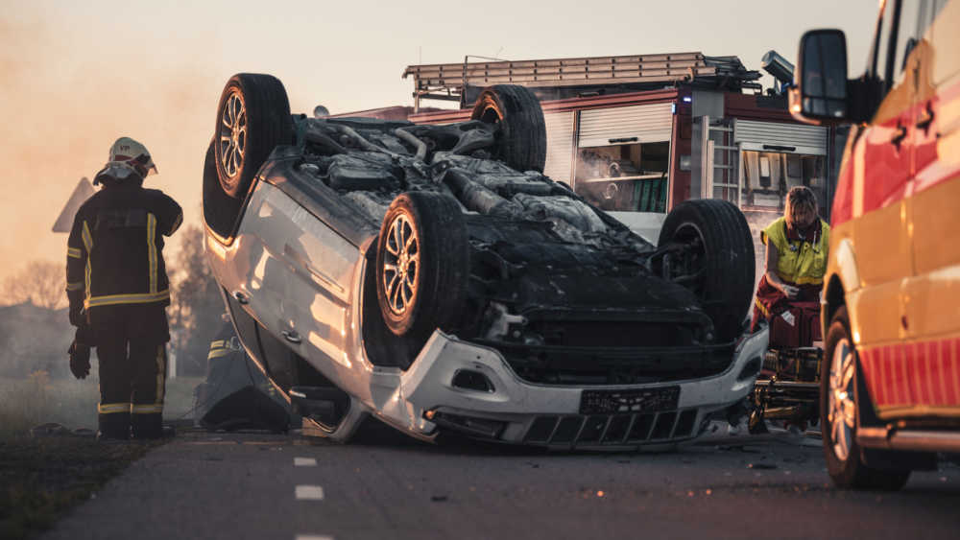
Data analysis
1. Crash Trends Over Time
The crashes are at their highest point in the afternoon and at early evening.
Trends of accidents show that there are seasons that have more accidents per month.
2. Environmental Factors
Majority of the crashes happen in a clear or a cloudy weather.
Such conditions of the road surfaces as wet or icy roads are dangerous.
Lighting conditions: most of the crashes take place in the daytime but a considerable amount of crashes takes place in the dusk or dark.
3. Crash Cause Patterns
Failure to yield, improper turning and following too closely are common major contributory causes.
The rare causes are combined into Other to enhance the performance of the model.
4. Correlations & Patterns
Bad crashes are more evident in high-speed regions.
The crashes on the weekdays have a time-related pattern in line with traffic flow.

Slide 7
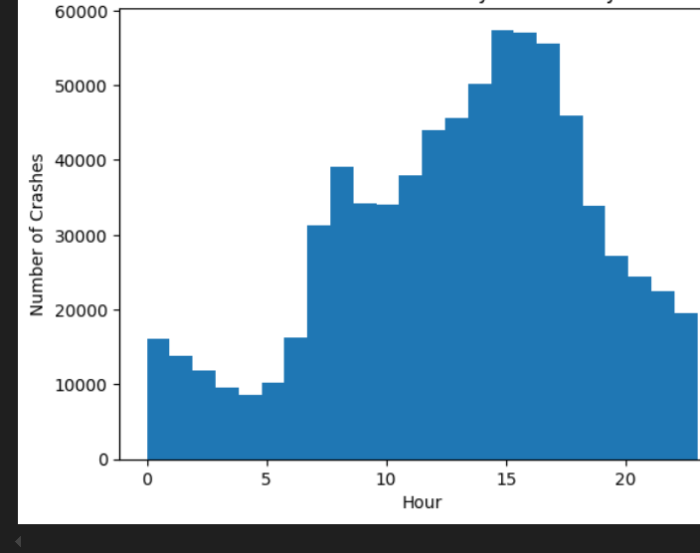
VISUALIZATION
This histogram shows how crashes are distributed across the 24-hour day.

Slide 8
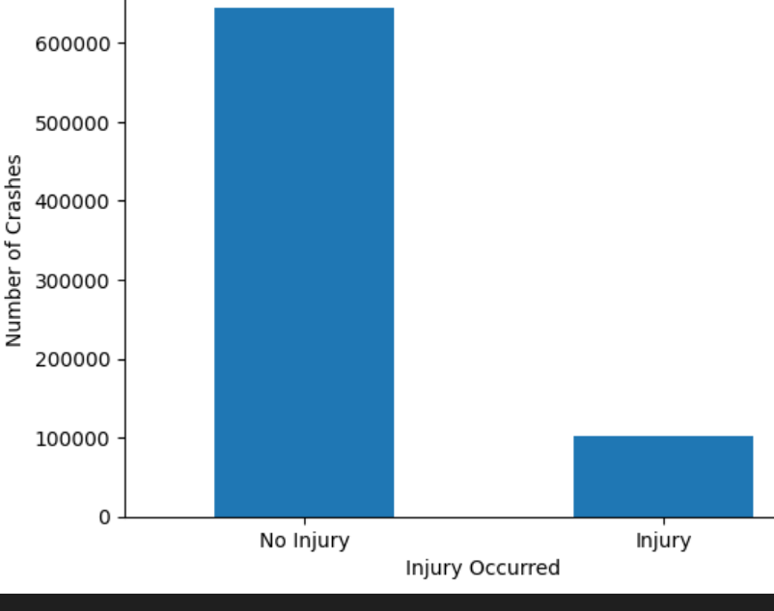
TARGET VARIABLE: INJURY OCCURRED Created a binary target variable which indicates whether a crash resulted in at least one injury.

Slide 9
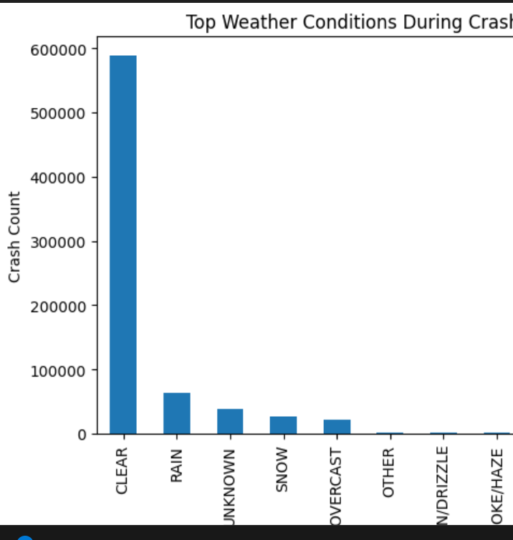
Weather Condition Distribution
The bar chart below highlights the most common weather conditions during reported crashes.

Slide 10
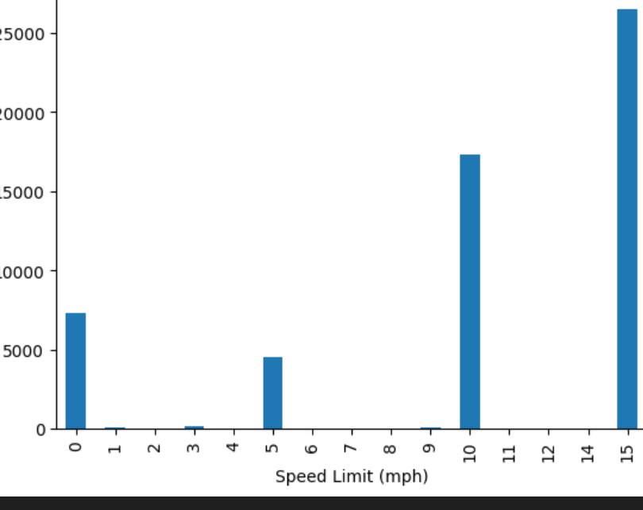
Speed Limit Distribution

Slide 11
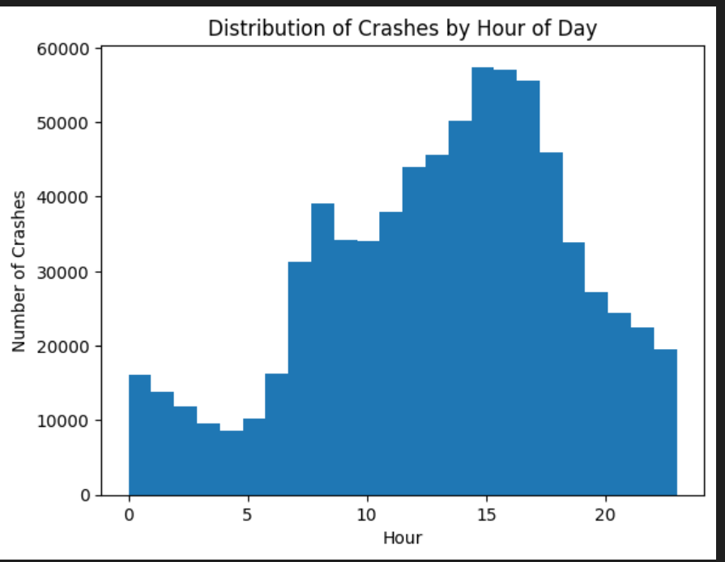
Crash Hour Distribution

Slide 12
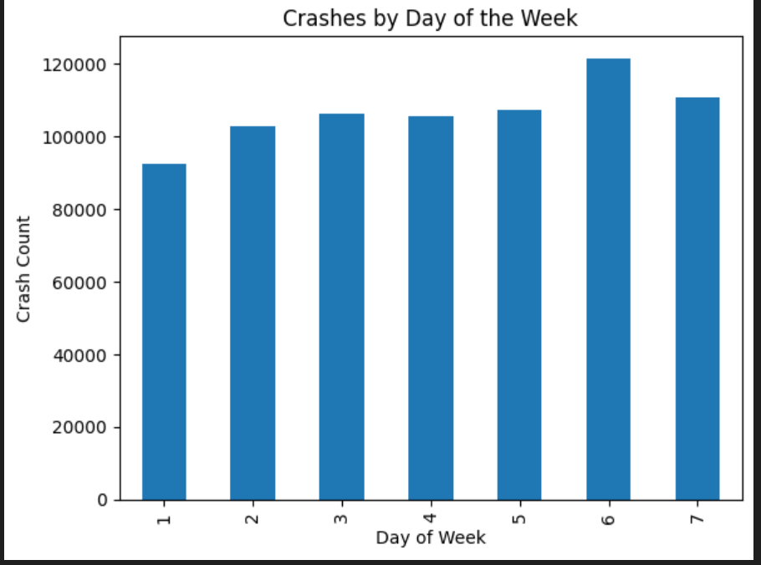
Day of Week Distribution

Slide 13
FINDINGS FROM THE DATA ANALYSIS
There are hours, lighting, and road conditions that are closely linked to a certain type of accident.
Weather does not necessarily play a key role, but human behavior (such as lack of yield or bad maneuvers) prevails.
Random Forest classifies crash hour, road surface, and lighting to be significant predictors of cause of crash.

Slide 14

BUSINESS RECOMMENDATIONS FOR CRASH ACCIDENT
Targeted Enforcement: Traffic monitoring and enforcement should be done on high-risk hours (afternoon/evening).
Road Safety Campaigns: train drivers on the art of yielding, making good turns and safe following distance.
Infrastructure Enrichments: Improve the lighting facilities in prone areas to accidents and on road surfaces, particularly in the case of adverse weather.
Policy Support: Predict and match to Vision Zero efforts and curb injuries and deaths.

Slide 15
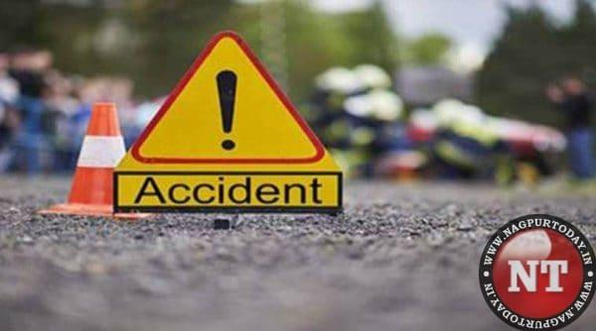
CONCLUSION
Through the analysis of the historical crash data and using machine learning, it is possible to estimate the primary contributory causes of accidents with a fair degree of accuracy. The results emphasize that the driver behavior and traffic conditions are essential elements, which can offer practical implications to policymakers, city planners, and the representatives of the public safety. Application of specific interventions, depending on these understandings, can avert accidents, injuries, and fatalities.
This Photo by Unknown Author is licensed under CC BY-SA-NC

Slide 16
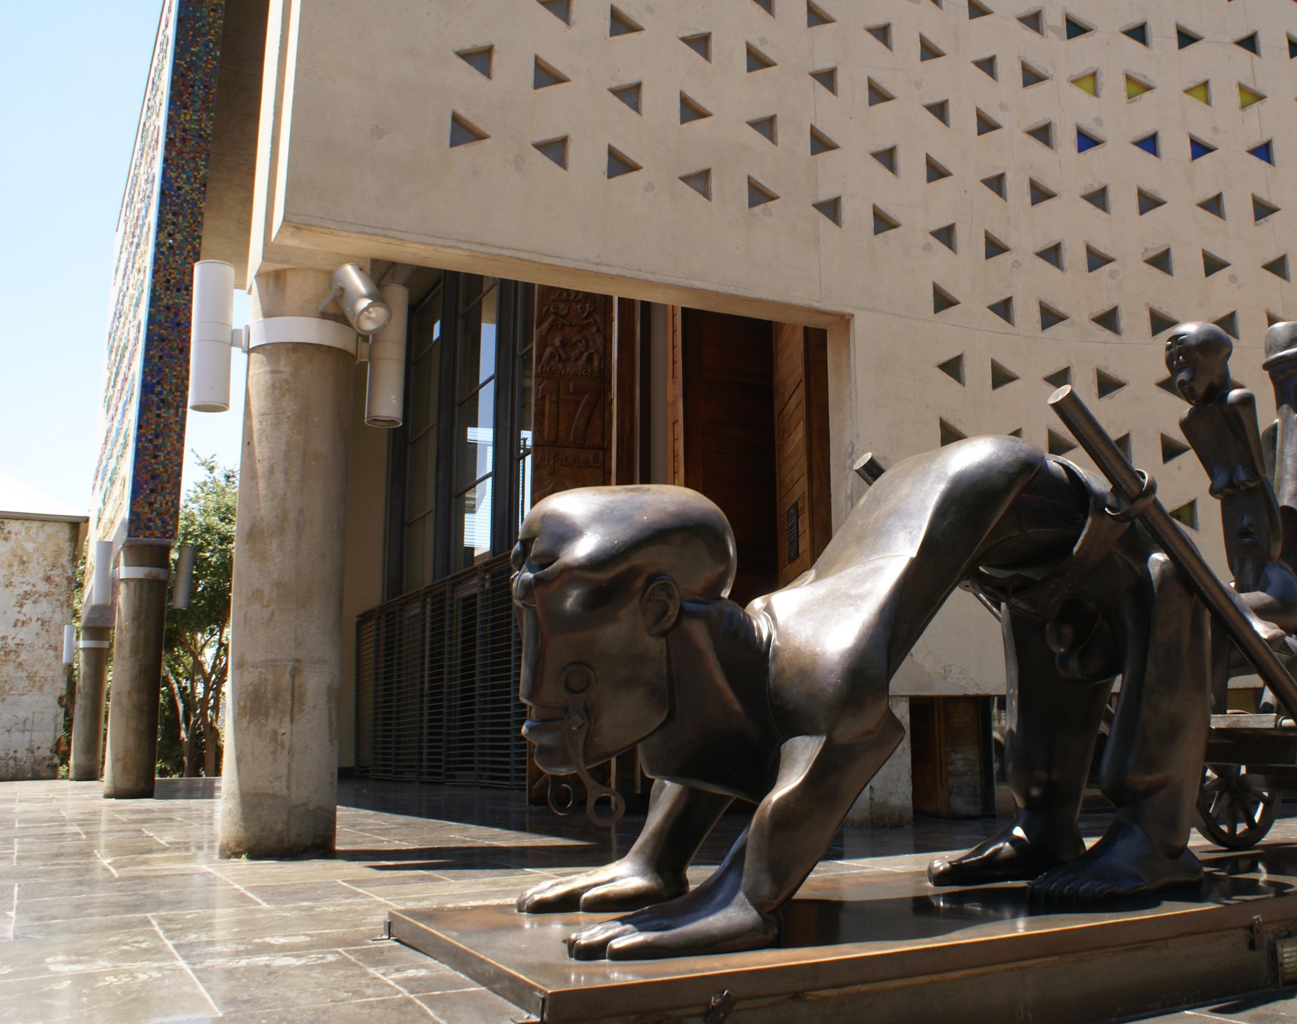
thank You for your time
Open to any questions
Email: Kiraguaxle@gmail.com
Phone:0718584873
This Photo by Unknown Author is licensed under CC BY-ND

